Slide 1
So, you wanna give a tech talk? David Makogon, Microsoft
#novacodecamp
@dmakogon
www.dmak.io

Slide 2

Imagine that Great Amazing Thing you just worked on, and OH WHAT A STORY YOU COULD TELL! It has bells, whistles, drama, intrigue. There's some crafty code and a rarely-used workaround that could Change The World As We Know It! It talks about a new framework! And you have jokes! And pictures! And and and...
And... you have a huge audience filling seats. Different backgrounds. Different primary spoken language. Different eyesight & hearing. Different coding skills. Different attention spans. HOW WILL YOU SURVIVE!?!?
Having given, and watched, a huge bunch* of talks worldwide, I've learned many things that help (and hurt) presentations. In this talk, I'll attempt to use the "things that help" to show you things that help AND things that hurt** in hopes that all of our future talks can help more and hurt less.
*Huge bunch : a ridiculously-high number that gets larger every time I tell the story ** These things don't really hurt. But they may make you cringe. Or sigh. Or gasp.

Slide 3
Real simple agenda
Speaking tips n tricks (really, that's it)
Primarily for tech talks
Sorta applies to all talks

Slide 4
Tip+trick topics
The intro
Avoiding eye charts
Code editors and shells
Human interaction
Dealing with problems
Pre-talk prep

Slide 5
The intro…

Slide 6
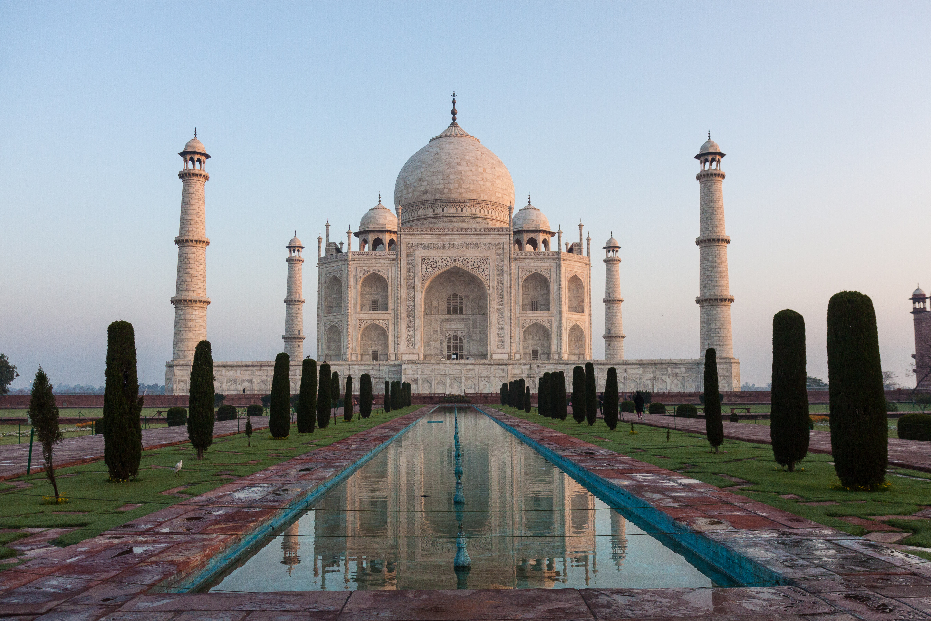

Who am I??? (hint: → David Makogon)
Azure architect
Camera carrier
Pun penner
NoSQL non-novice
Community congrat collector
- (World's first former) Azure MVP
- (Former) MongoDB Master
- Neo4j Ambassador
If there's one thing that's not clear to me, it's opaqueness.

Slide 7
Eye charts

Slide 8
Obligatory "bullet" eye-chart slide
Think about the content you're showing. Do you really need bullets at all? Does the little dot on the left help, or just look like annoying dots down the page?
Should bullets be shown all at once, or slow-rolled so that your audience can follow along?
Do you really need to write entire paragraphs to get your point across, or maybe you could just reduce to a few key words?

Slide 9
Bullets (or not)
Bullets:
Yay?
Nay?
Make your point with few words, speak the rest

Slide 10
Code eyecharts
view.on('init', function (next) {
var q = keystone.list('Post').paginate({
page: req.query.page || 1,
perPage: 10,
maxPages: 10,
filters: {
state: 'published',
},
})
.sort('-publishedDate')
.populate('author categories');
if (locals.data.category) {
q.where('categories').in([locals.data.category]);
}
q.exec(function (err, results) {
locals.data.posts = results;
next(err);
});
});
var q = keystone.list('Post').paginate({
page: req.query.page || 1,
perPage: 10,
maxPages: 10,
filters: {
state: 'published',
},
})
.sort('-publishedDate')
.populate('author categories');
Keystone.js – blog post listing
view.on('init', function (next) {
var q = keystone.list('Post').paginate({
page: req.query.page || 1,
perPage: 10,
maxPages: 10,
filters: {
state: 'published',
},
})
.sort('-publishedDate')
.populate('author categories');
if (locals.data.category) {
q.where('categories').in([locals.data.category]);
}
q.exec(function (err, results) {
locals.data.posts = results;
next(err);
});
});

Slide 11
Code editors and shells…

Slide 12
Human interaction

Slide 13
Know your audience
Skill level and background – ask
Primary language (in general)
Assignment: look around you
Notes:
Advanced topic with beginners? Language barrier? Diversity!

Slide 14
Jokes
Political
There are 10 types of people:
Those who understand binary… And those who don’t
Off-color
Adult
Country-specific

Slide 15
Your voice
The volume
The direction
The mic
Notes:
Mic: learn to turn off (drinking, coughing)
Don’t face the screen when talking
Project your voice if no mic.
Always use mic! Clip-on is best
Remember the back of the room

Slide 16
Your location
Where are you hiding???
Are you moving?

Slide 17
Highlighting
Pointing devices
Hand gestures
Zooming
“As you can see…”

Slide 18
Terms and acronyms
Don’t assume people know them!
You know them. Explain them.

Slide 19
Q&A – what to do
Look for raised hands
Repeat
Repeat
Repeat
Repeat
Repeat
Repeat
Save to the end?
Interactive?
It’s ok to cut short
(politely)
“I don’t know” is ok

Slide 20
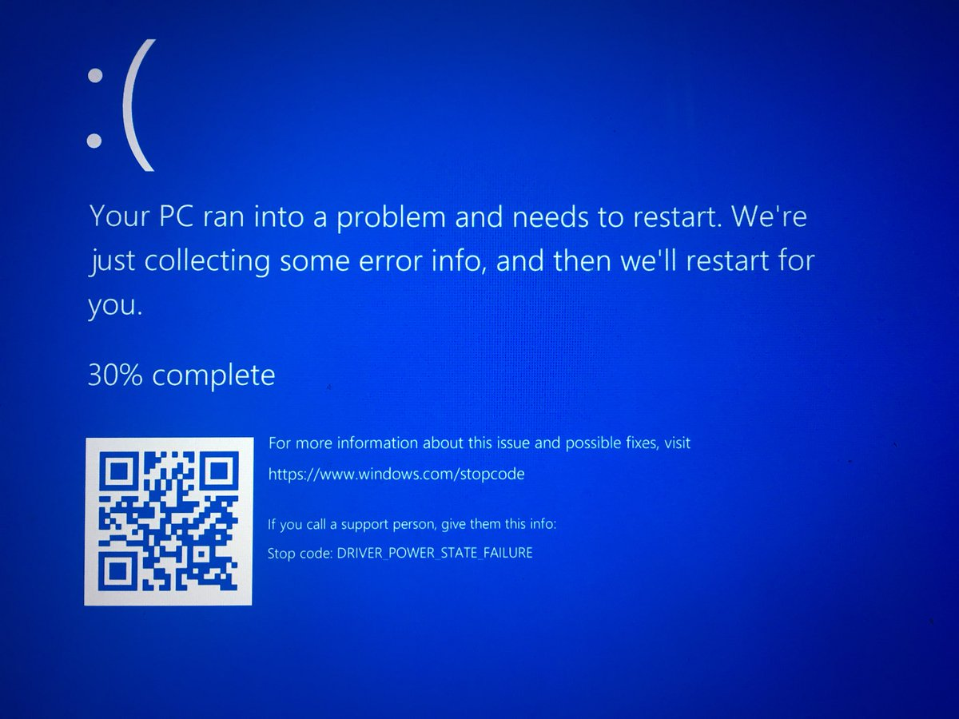

Slide 21
Dealing with problems

Slide 22
Dealing with problems
Computer crash
Network failure
Mouse failure
Clicker failure
Demo failure
“Dead air”
Meltdown

Slide 23
Computer crash
Assume complete failure
Second computer?
Borrow computer?
Whiteboard?
Just… speak?
Notes:
Borrow / second computer: careful. Needs same tools, same presentation app

Slide 24
Network failure
Most demos can be run locally
Cloud? Tricky
Local emulators
Local databases
Local web/app servers

Slide 25
Demo failure
Won’t compile? Throws errors?
Live-coding is risky. Awesome, but risky.
Snippets
Backup (or-primary) project, done, pre-tested
Screen recording of live-coding

Slide 26
Dead air
Some things take a while
Some things require typing
Narrate
Talk through things

Slide 27
Meltdown
Talks are fun! But… Sometimes nerves win.
Totally ok to be nervous!
Take a moment, if you need it
Stay comfortable – maybe sit, hide a bit?
Maybe ask for questions? Insert a story?

Slide 28
Organizing your talk

Slide 29
Content to consider
Drawings
Code libraries
Github repo’s
Code
Running demos
Data-viewing
Debugging

Slide 30
Non-tech content to consider
Title slide with simple contact info
Intro slide
Topic and summary slides
Closing slide with contact info + links

Slide 31
Where do code & demo go?
Slides
Videos
Editors
Command shells
Web

Slide 32
Bouncing between apps
For my talk today:
PowerPoint
VSCode
Visual Studio
DOS prompt
Ubuntu shell
Browser

Slide 33
Bouncing between apps
Try to minimize switching
Don’t make people watch you alt-tab constantly
Keep minimal apps / tabs open

Slide 34
Pre-talk prep

Slide 35
Rehearsing and timing
New talk? Rehearse. A LOT.
Old talk? Rehearse. Just do it.
Clock time: don’t use it all.
Q&A
Unforeseen problems
Schedule delays

Slide 36
Where is a clock?
Countdown timers are great!
Consider “checkpoints’
It’s ok to skip stuff
Avoid tangents

Slide 37
Checklist - hardware
Charged laptop(s) + Power adapters
Video adapters
Network adapter
Hotspot
Clicker / pointer / mouse
Device batteries (charged, plus extras)

Slide 38
Checklist - software
Apps installed
Code downloaded / cloned
Directory-jump quick-links
Start / test utilities (e.g. ZoomIt)
Configure WiFi
Azure? Test non-web ports
Timezone: system clock

Slide 39
Checklist – non-essentials
Shut down email / chat
Shut unneeded browser tabs
Turn off:
screen savers
notifications
sleep
phone ringer

Slide 40
Checklist – personal
Clothing
Water/soda available
Stress toys / spinners
Props?
Hide your laptop bag
Are you ok with being recorded?

Slide 41
Checklist – before presenting
Arrive early
Screen / resolution test (slides, code, text)
Microphone test
Network test
Notes available
Bathroom break
Notes:
Mac and PC behave differently, with duplicating vs extending screens Extended screens – complex to move mouse around

Slide 42
Ready, set, present!

Slide 43
Summary
The intro
Avoiding eye charts
Code editors and shells
Human interaction
Dealing with problems
Pre-talk prep

Slide 44
Questions?
Keep in touch!
Twitter: @dmakogon
Blog: dmak.io
Talk stuff at github.com/dmakogon/novacc2017.2

